Slide 1

AI Study Buddy (Group 3) Interim Presentation
Team Project - MSc Computer Science
Rumaysa Babulkhair – D24125711
Anika Mayesha – D24125187
Lorenzo Palleschi – D24126922
Yurii Sykal – C23512523

Slide 2
What is AI Study Buddy?
Modern day web app for third-level students improving studying habits
Utilises AI to assist with numerous features
(Automated tutoring, content summarisation, intelligent feedback)

Slide 3
Primary Competitors
Existing System | Primary Features | Limitation vs Study Buddy
Quizlet | Flashcards, Study guides | Likely the greatest competitor, but withhold a lot of their content behind a paywall.
Gizmo.ai | Flashcards, gamified system | Lacks notetaking, & quiz generation.
Coral.ai | Summaries, quizzes | Paywall, no mock assessments or gamification.
Pomofocus | Productivity and focus tracking | Is an isolated service which contributes to the typical fragmented services.

Slide 4
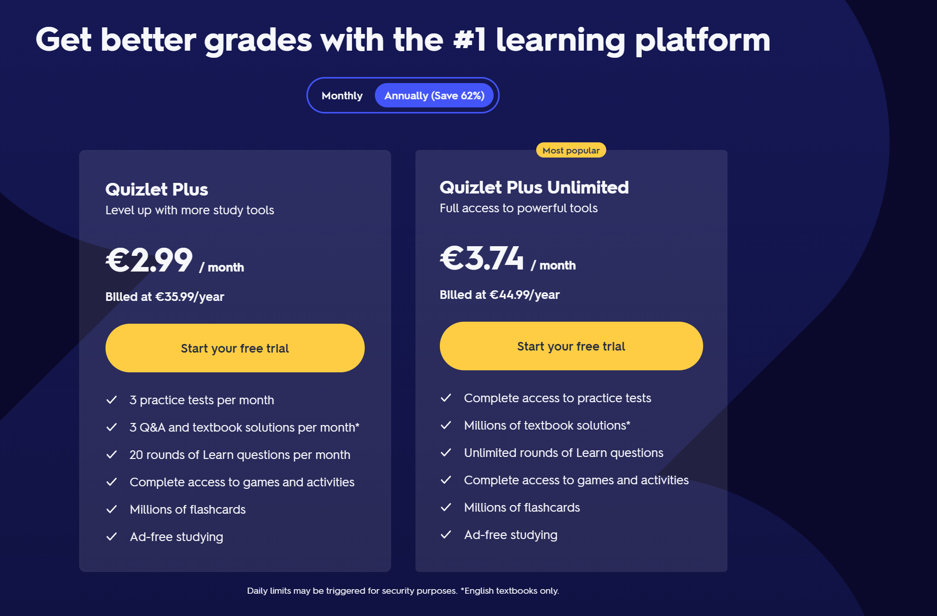
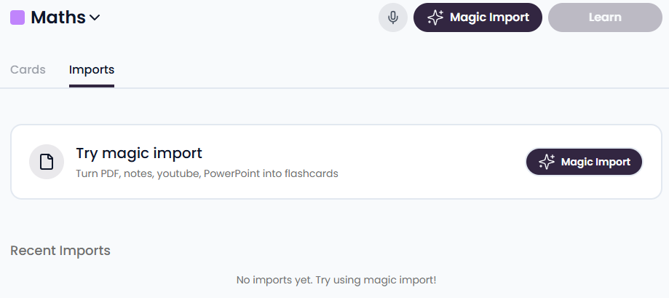
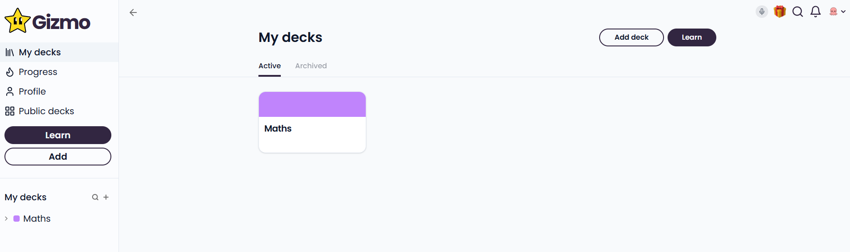
Competitor Shortfalls
Some top results are lacking in UI & Features
Notes:
No ai tutor, paywalls, bad ui

Slide 5
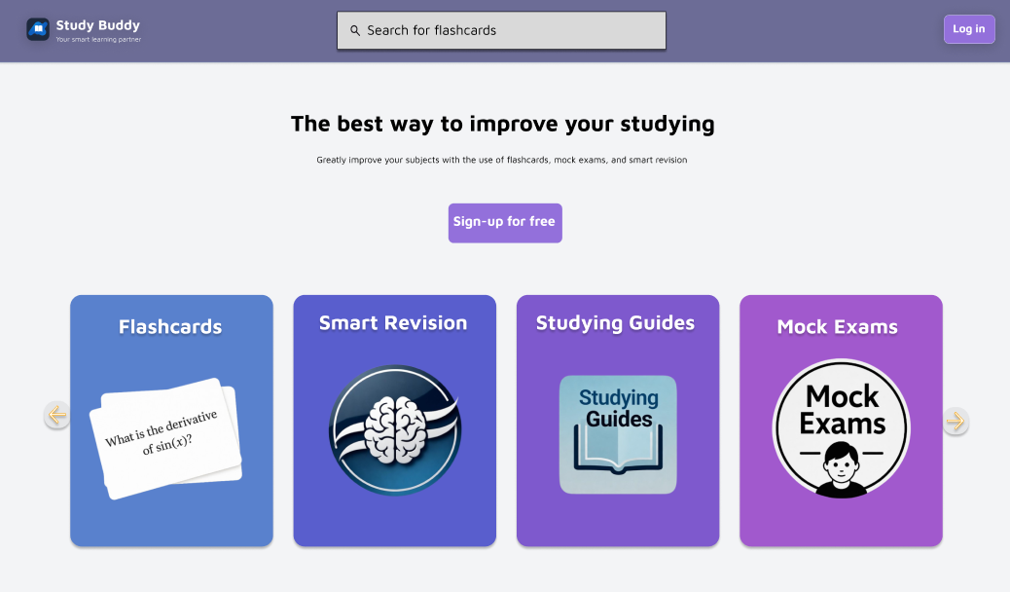
What we do Better
Free
Centralisation of features to avoid fragmentation
Interfacing
Notes:
40% increase in productivity by reducing fragmentation. (Rubenstein, 2001)
Don’t need to go to 10 different websites

Slide 6
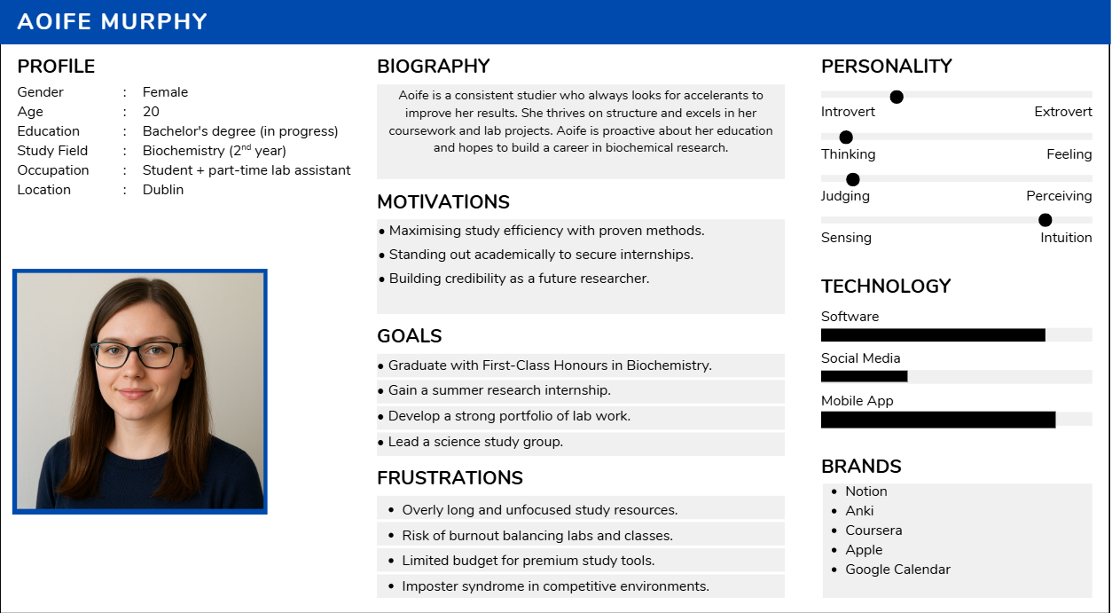
User Scenario: Target Users
Various university students

Slide 7
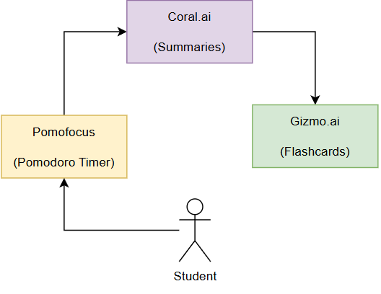
User Problems Solved
Fragmented Ecosystem: Centralised App
Low Motivation: Gamified achievements / Streaks
Adaptive Feedback: AI gap detection
Accessibility: OCR and various other inputs

Slide 8
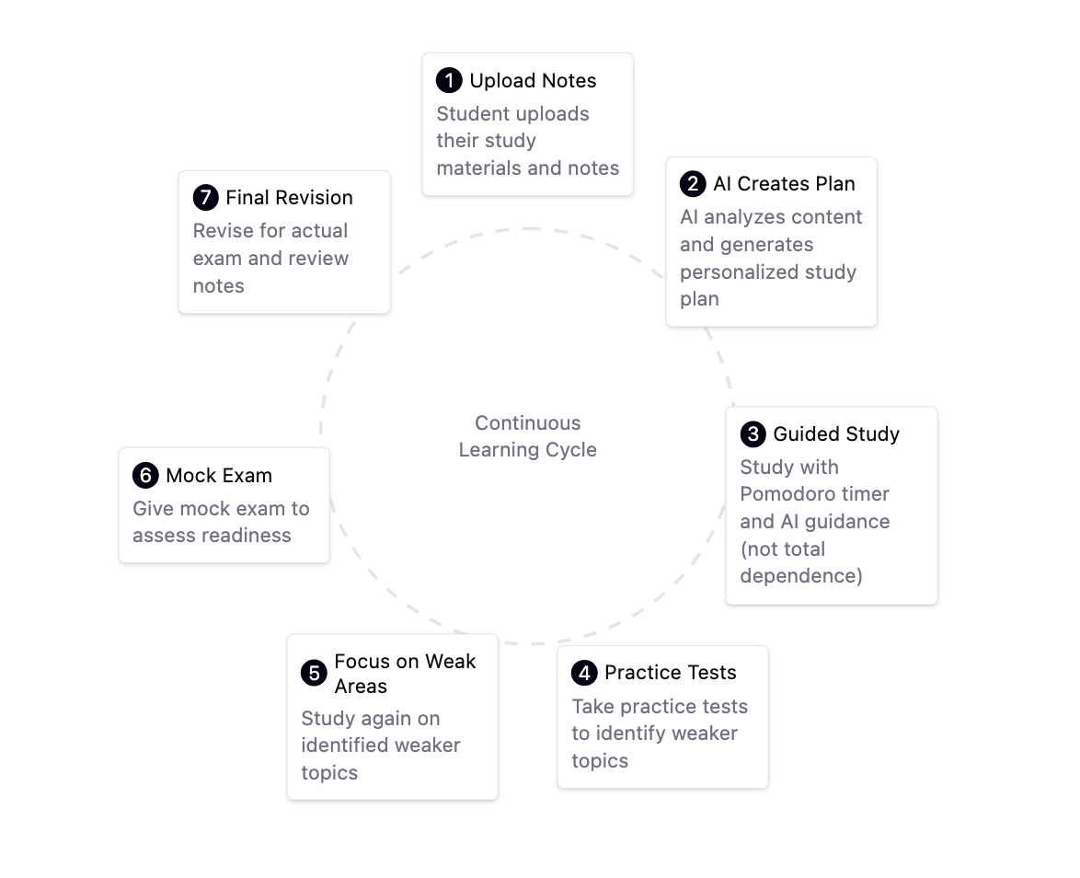
System Overview

Slide 9
Technical Problem
Multimodal Data Handling – Processing varied inputs
Context Retention - Retaining user notes and quiz data
Latency & Scalability – Reponses must be swift
Data management – GDPR compliancy

Slide 10
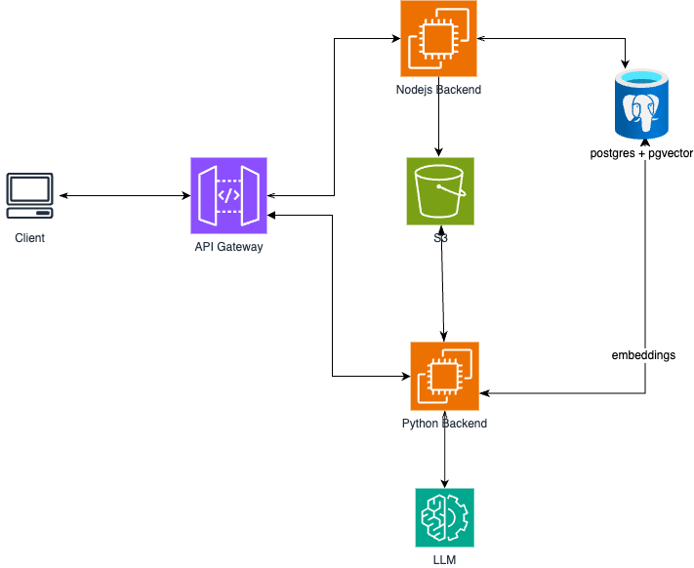
How it works: Architecture

Slide 11
Evaluation: Defining and Measuring Success
Criterion | Desired Metric | Evaluation Method
Summary Accuracy | ≥ 80% relevant content | Semantic comparator
System Usability (SUS) | ≥ 80 | User survey
Task Completion Rate | ≥ 90% | Cognitive walkthrough
Average Task Time | < 2 minutes | System logs
Motivation factor | +20% increase reported | Questionnaire
Learning Improvement | ≥ 15% quiz score | Controlled study

Slide 12
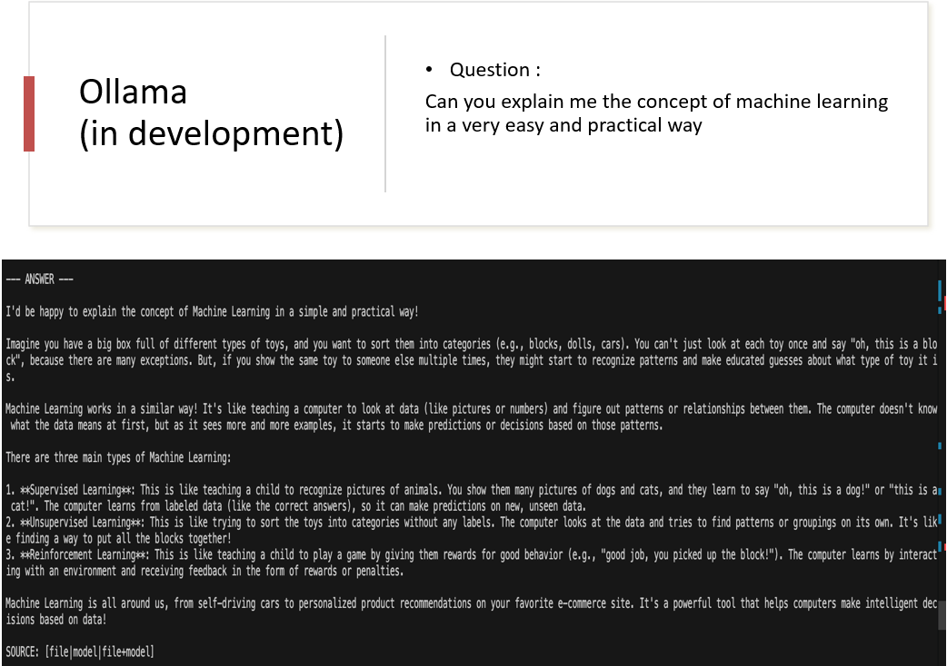
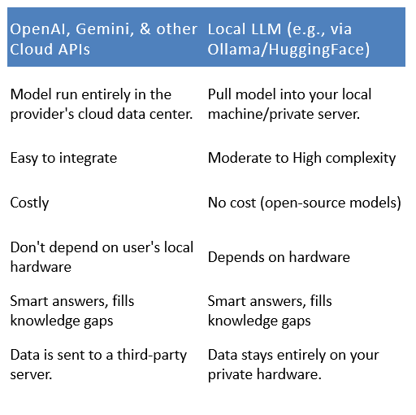
AI Coverage & Future work
LLM APIs Comparison
Change frontend design to new version
1
Use Local LLM
2
Integrate Multimodal AI Capabilities
3

Slide 13
Conclusion and Expected Outcomes
Development will continue as features arise
UI will continue to improve
System backend can be improved to reduce latency
Cornell method to be integrated
Evaluation cycles
AI Study Buddy should serve as a centralised service, outshining competition

Slide 14
References
Python (2025): Retrieved from: https://docs.python.org/3/
PostgreSQL (2025): Retrieved from: https://www.postgresql.org/docs/
OECD. Digital Education Outlook (2023): Towards an Effective Digital Education Ecosystem. Retrieved from: https://www.oecd.org/content/dam/oecd/en/publications/reports/2023/12/oecd-digital-education-outlook-2023_c827b81a/c74f03de-en.pdf
HEA. Higher Education Authority (2025): Student data. Retrieved from: https://hea.ie/statistics/data-for-download-and-visualisations/access-our-data/Access%20our%20Data%20-%20Students/
Deci, E.L, & Ryan, R.M. (2000): The “What” and “Why” of Goal Pursuits: Human Needs and the Self-Determination of Behavior. Retrieved from: https://selfdeterminationtheory.org/SDT/documents/2000_DeciRyan_PIWhatWhy.pdf
Rubinstein, J. S, Meyer, D.E., & Evans, J.E. (2001): Executive Control of Cognitive Processes in Task Switching. Retrieved from: https://www.researchgate.net/publication/11827832_Executive_Control_of_Cognitive_Processes_in_Task_Switching
Hamari, Juho., Kolvisto, J., Sarsa, H. (2014): Does Gamification Work? Retrieved from: https://ieeexplore.ieee.org/document/6758978
Luckin, Rose., Holmes, W. (2016): An Argument for AI in Education. Retrieved from: https://www.researchgate.net/publication/299561597_Intelligence_Unleashed_An_argument_for_AI_in_Education
Nielsen, Jakob. (1994): Nielsen’s Heuristics. Retrieved from: https://thedecisionlab.com/reference-guide/design/nielsens-heuristics

Slide 15
Thank You
Any Questions?

